Slide 1
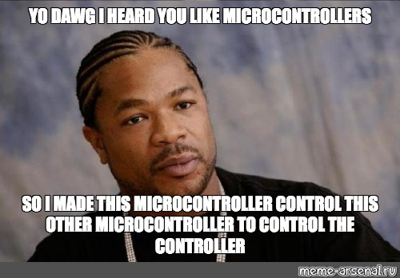
Microcontrollers
Arduino
SUTD ORGANIZATION OF AUTONOMOUS ROBOTICS
Notes:
I will be talking about microcontrollers today and you will be using this for your soar challenge. Arduino will be used to teach in this course.

Slide 2
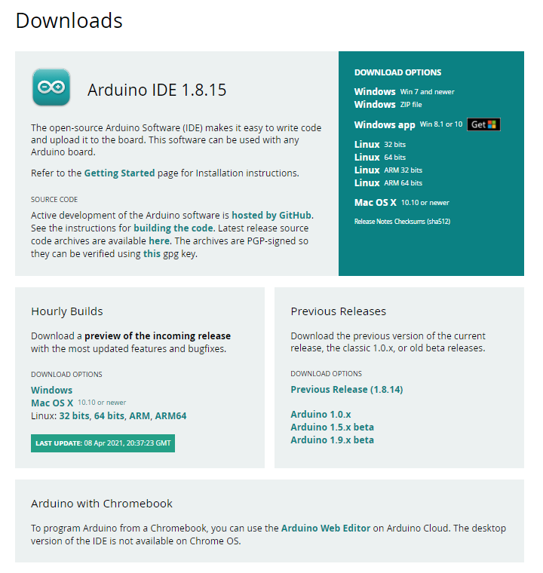
Arduino IDE
5 Minutes
https://www.arduino.cc/en/software
A compiler to program an Arduino microcontroller.
Do not install from “Windows app”.
Notes:
Before we start, I will need all of you to enter the following link and download the latest Arduino compiler for this course. Do not install the windows app.

Slide 3
Microcontrollers
An integrated circuit board.
Many inputs/outputs pins.
Programmable to perform certain task.
Not all microcontrollers are built the same
Introduction
Notes:
So, what is a microcontroller? A microcontroller is an integrated circuit board, with many inputs and output pins, and can be programmed to perform task. However, not all microcontroller are built the same.

Slide 4

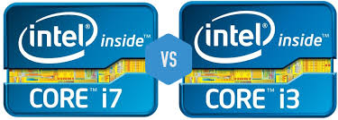
How to choose a microcontroller?
Cost
System requirements
Notes:
Since not all microcontroller are build the same, then how do I choose it? It depends on the cost and the system requirements of your project.
For instance, you need faster clock speed, better audio output, smaller controller, more memory, etc.
Of course you may get the best microcontroller for all of your projects but that will incur a higher cost for your project. Its like buying an intel i9 CPU to run only on word document.

Slide 5
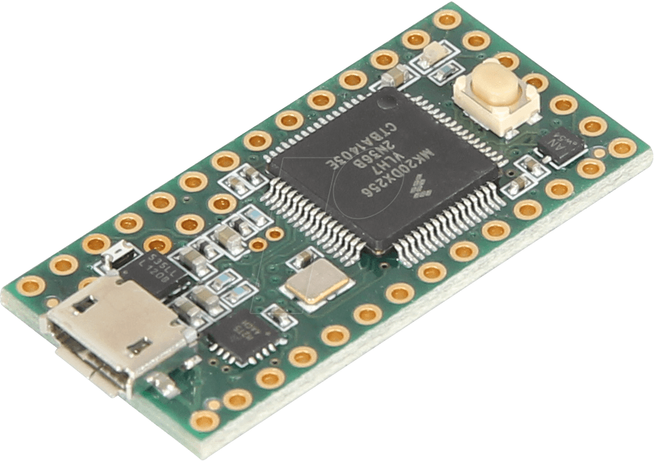
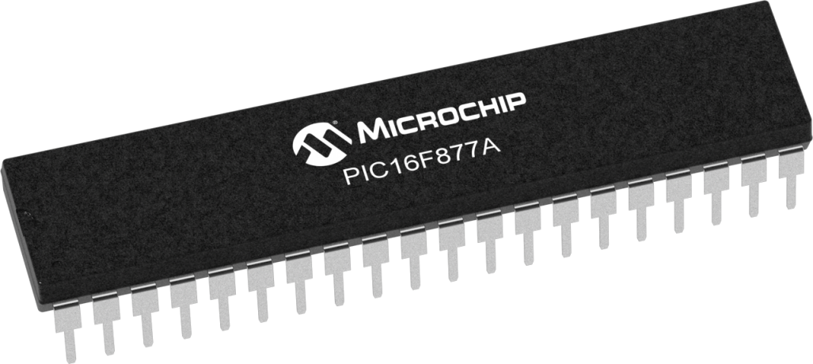
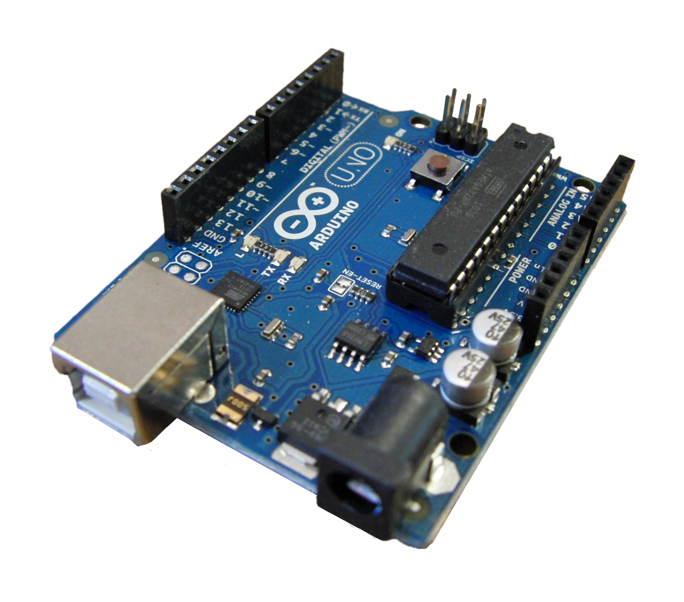
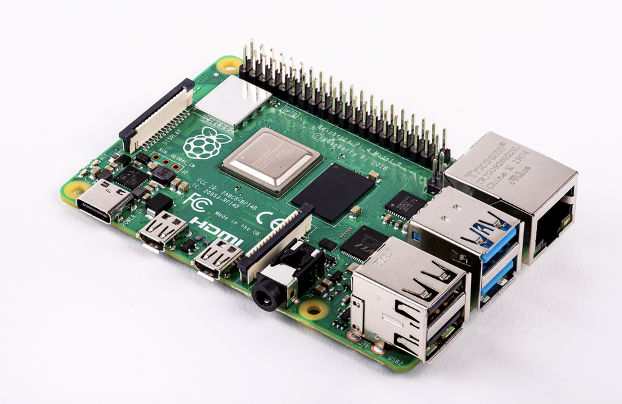
Microcontrollers
Rasberry Pi
Arduino
PIC
Teensy
Notes:
When I say microcontroller, I do not mean I know how to program an Arduino, but knowing the basic fundamental of a microcontroller and program them to perform specific task. This slides shows some brands or company that manufacture microcontroller. All these microcontrollers require different compiler but the methods used in programming are the same.

Slide 6

Check the voltage requirement of the microcontroller!
(Fireworks may occur)
Notes:
Always check the input/output voltage of the microcontroller. Different devices run on different voltage, the most common ones are 3.3V, 5V and 9V. You rarely see 36V but they do exist.

Slide 7
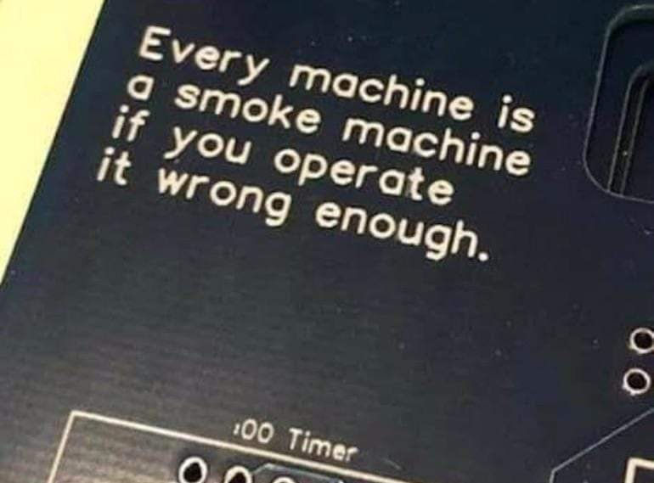

Slide 8
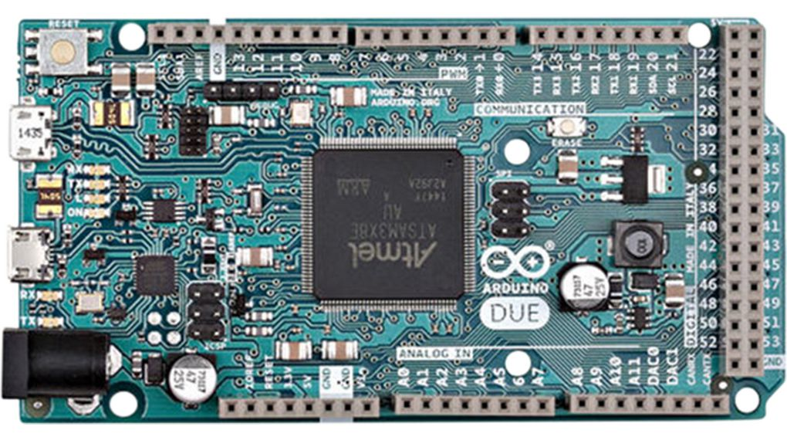
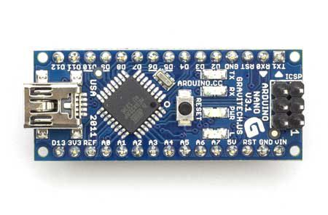
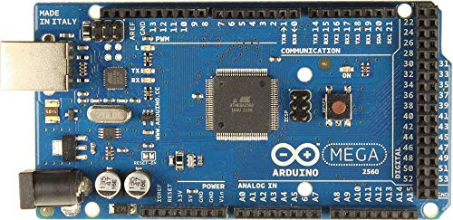

Arduino

Slide 9

Microcontrollers are still too EXPENSIVE!
Notes:
Always check the input/output voltage of the microcontroller. Different devices run on different voltage, the most common ones are 3.3V, 5V and 9V. You rarely see 36V but they do exist.

Slide 10
3rd Party Microcontroller
Do not differ much from the original unless your program is computing intensive.
Some uses a different chipset.
Some require additional driver.

Slide 11
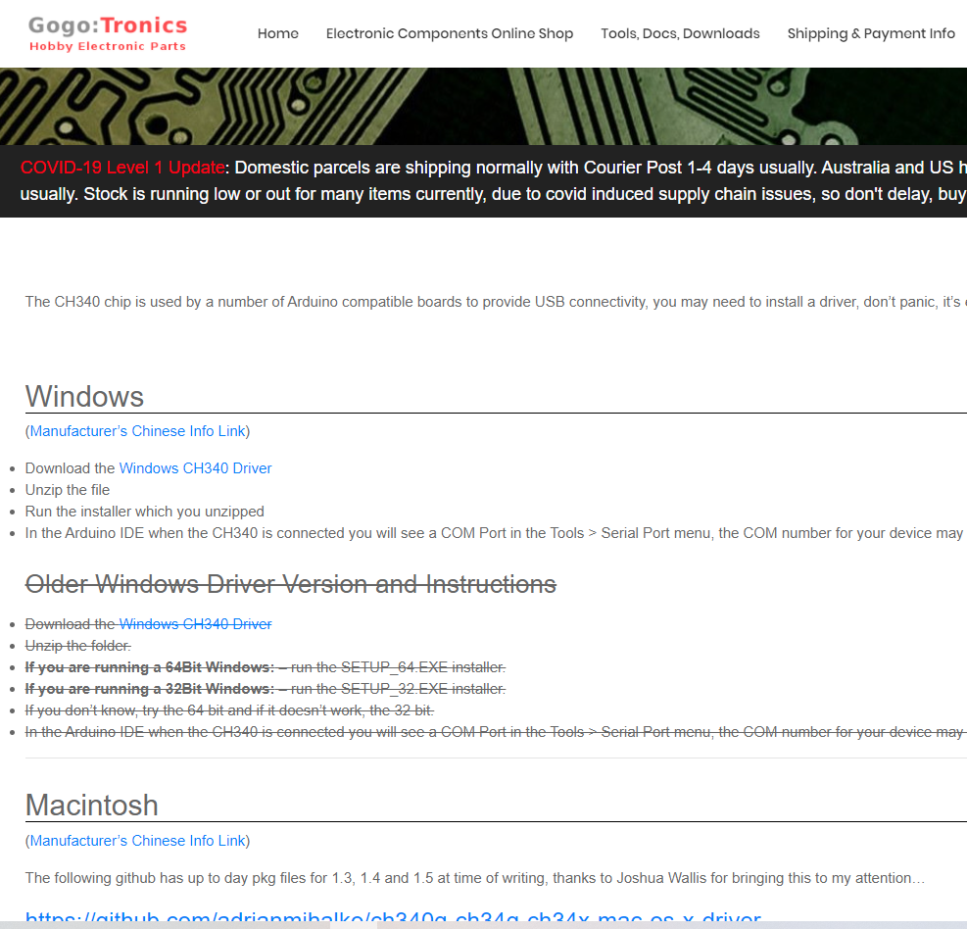
CH340 Driver
5 Minutes
https://sparks.gogo.co.nz/ch340.html
- Driver to run the Chinese make 3rd party Arduino
Notes:
Before we start, I will need all of you to enter the following link and download the latest Arduino compiler for this course. Do not install the windows app.

Slide 12
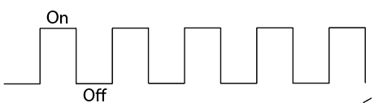
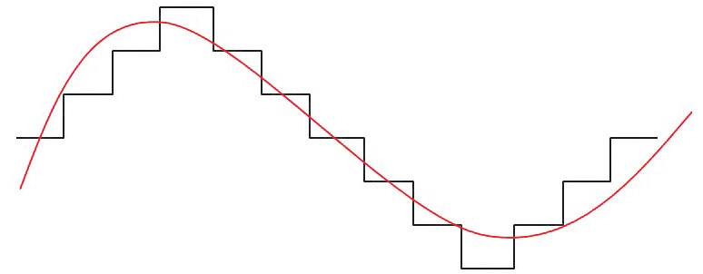

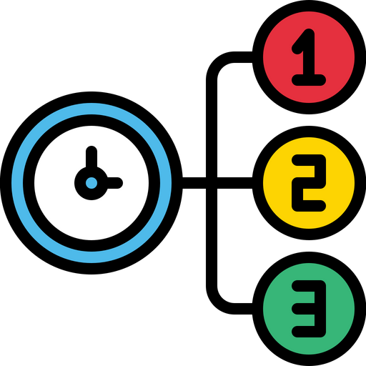
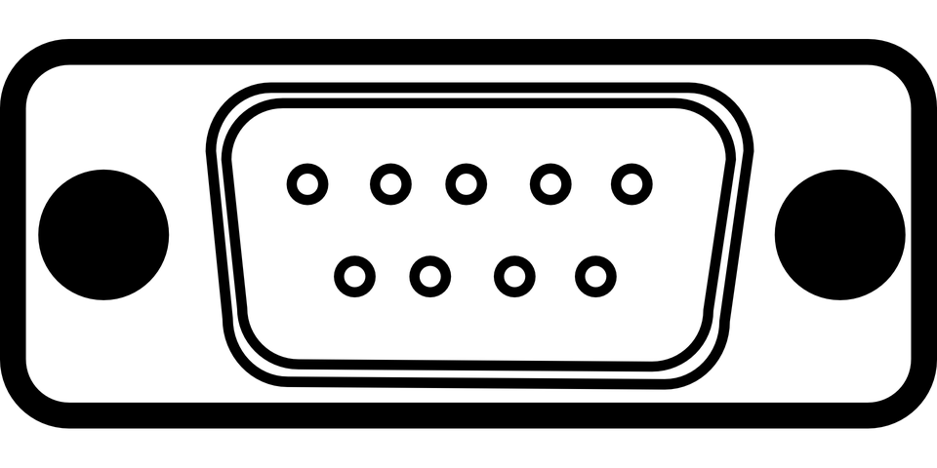
Built in functions in a microcontroller
Digital input/Output
Analog input/Output
PWM
5V
Ground
Read notes if you are interested!
Timer
Interrupts
Communications

Slide 13
Arduino Compiler
Verify
Upload
Board type
Baud rate
Com port
Install new libraries
Getting examples code

Slide 14
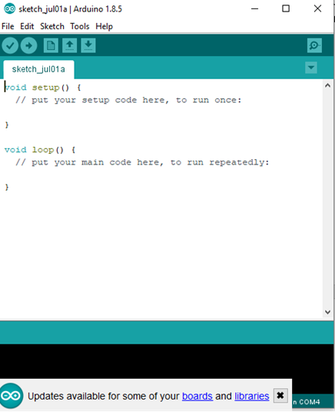
Serial Monitor
Arduino file is called “Sketch”
Verify sketch
setup() runs once on boot up
Compile and flash sketch to arduino
loop() runs constantly after running setup()
Notes:
Teach Serial monitor before moving on to blink led

Slide 15
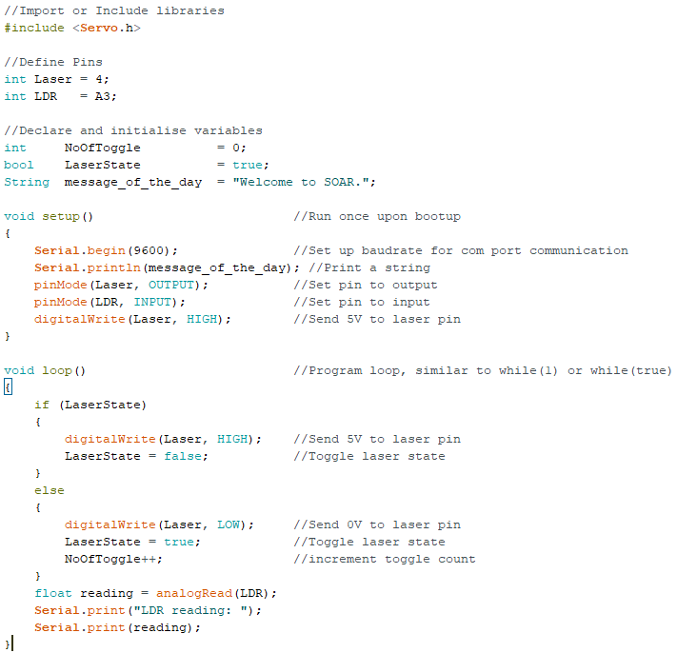
Rules to programming
Import/ Include
Declare pins
Declare and initialize
Setup
Program

Slide 16
Variables
Global Variable
Global
Variable used by many function
Local
Variable used within a function.
Function
Local Variable

Slide 17
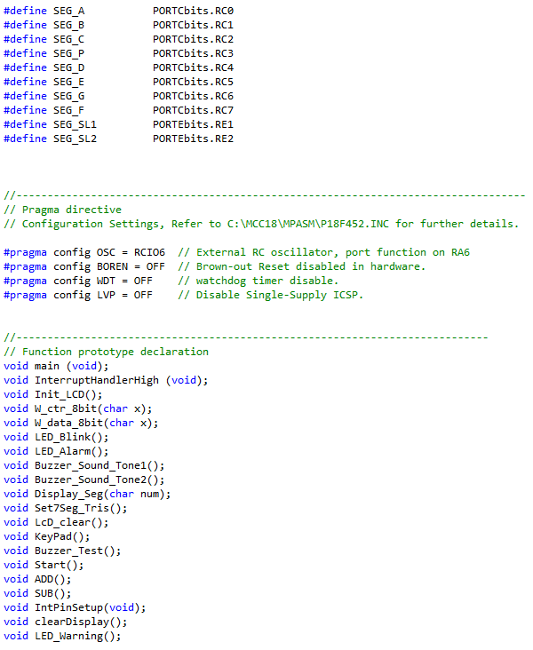
Other Microcontroller
#define
To define a pin instead of using “int”
Different pin naming
Declare a function in order to use the function
PIC controller

Slide 18
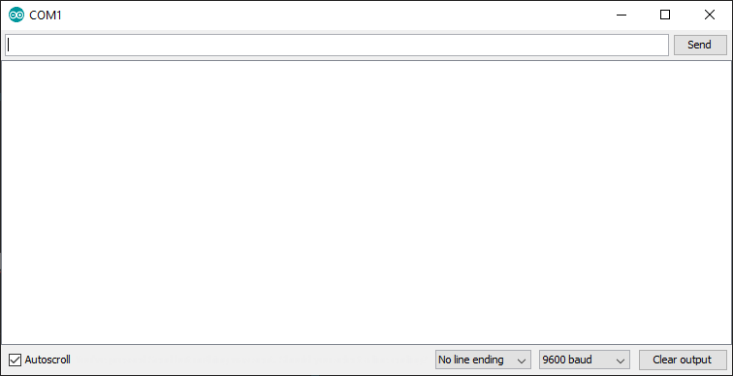
Serial Communication
User’s Input
Task:
Set Baudrate
Print “Hello World”
Read from comport
Serial prints
Change Baudrate

Slide 19
Programming microcontroller
Import
Functions
Loops
Conditionals
Operators
Next Lesson!

Slide 20
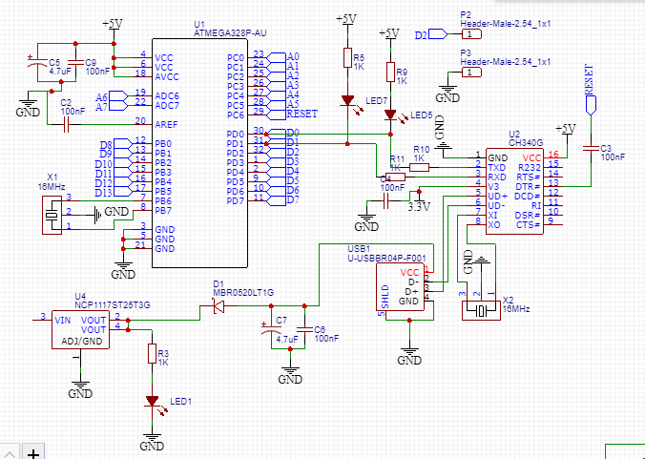
Schematics
A blueprint for a component.
Shows how the component is wired.

Slide 21
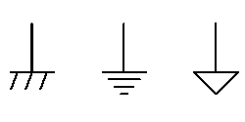
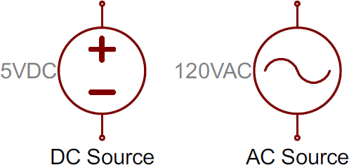
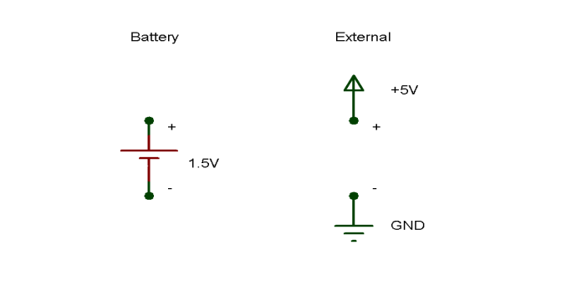
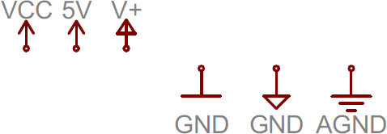
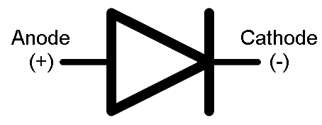
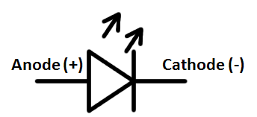

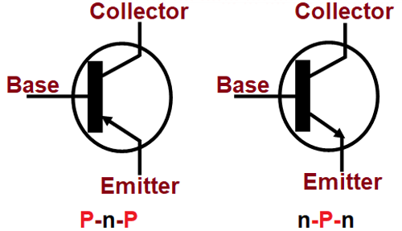
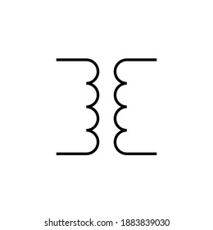
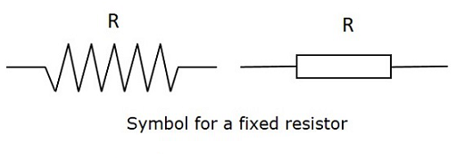
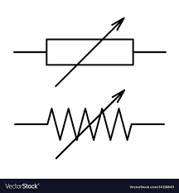
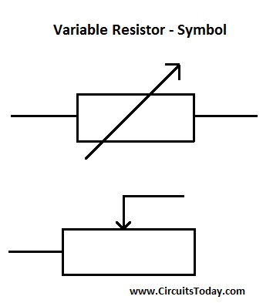
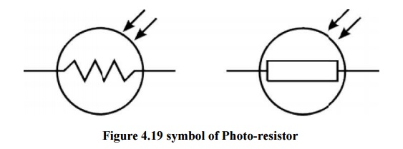

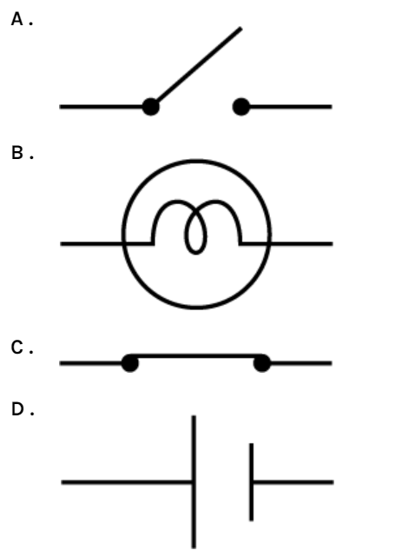
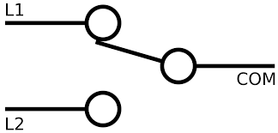
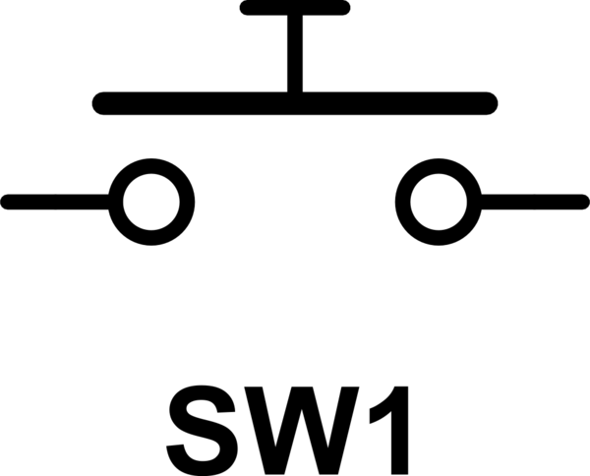
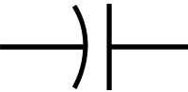
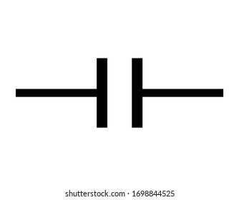
Basic symbols
Ground
Power Source
Battery
Power
Diode
LED
How individual component work?
ATTEND PHYSICS LESSON!
Required to understand how circuit work!
Variable Resistors
Light Dependent Resistor
Crystal
Transistor
Resistors
Transformer
Light bulb
Switch
Switch
Push buttons
Electrolyte Capacitor
Ceramic Capacitor

Slide 22
Hints on some circuit
Capacitor
Transistors
Resistors
Smoothen signals
Ensure circuit runs at a constant voltage
Allows the running of components that require more power than what the microcontroller can provide
Higher resistance equals lower power consumption.
Can be used to read high voltage signal with lower power consumption.

Slide 23
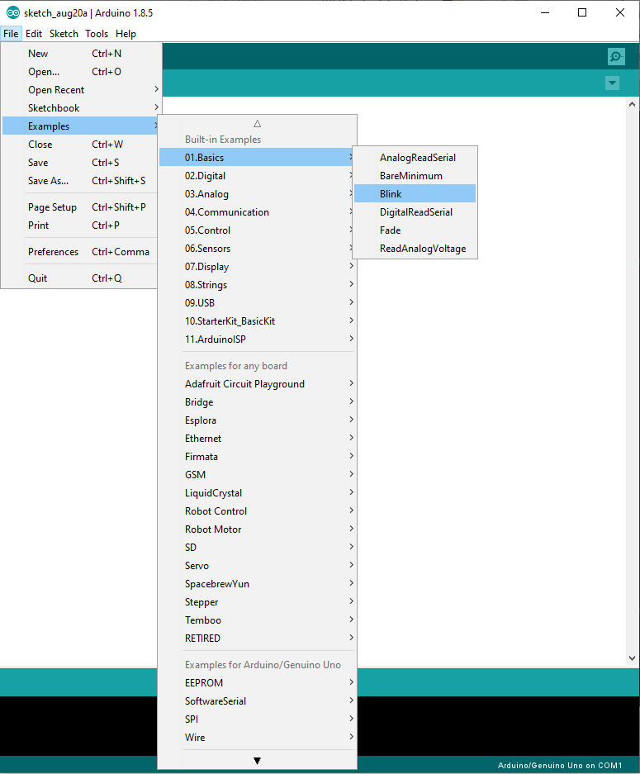
Activity (Blinking LED)
Open blinking LED examples
Run blinking
Print the state of the LED

Slide 24
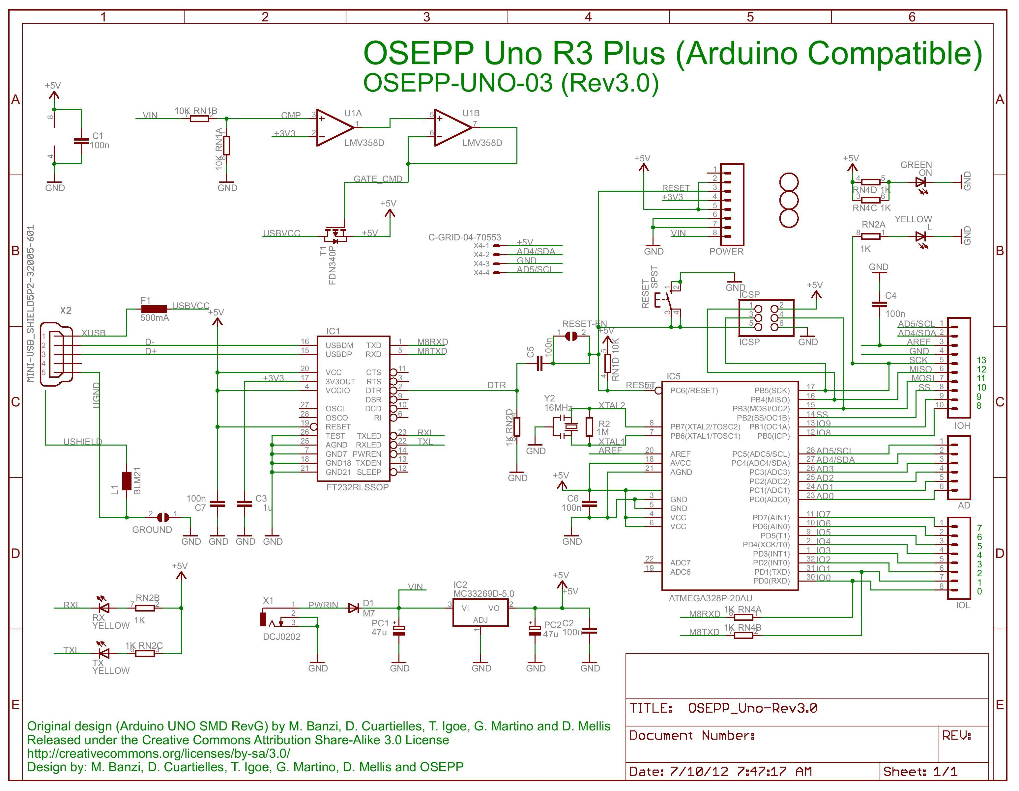
How does it work?
Look at pin 13 wiring
LED_BUILTIN is not editable
LED_BUILTIN references to pin 13 (on board LED)

